Slide 1
NRC videos …
Greenhouse Gases and Increased Emissions

Slide 2
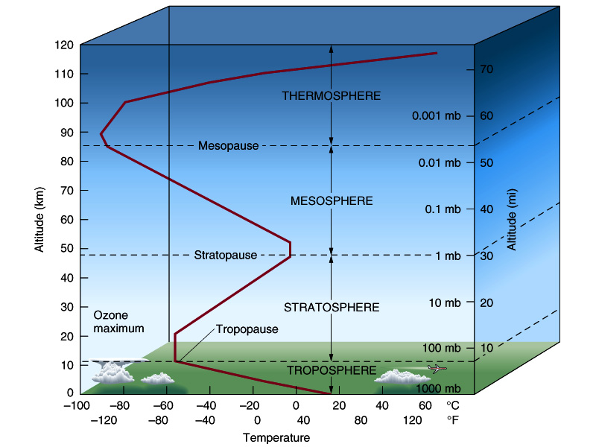
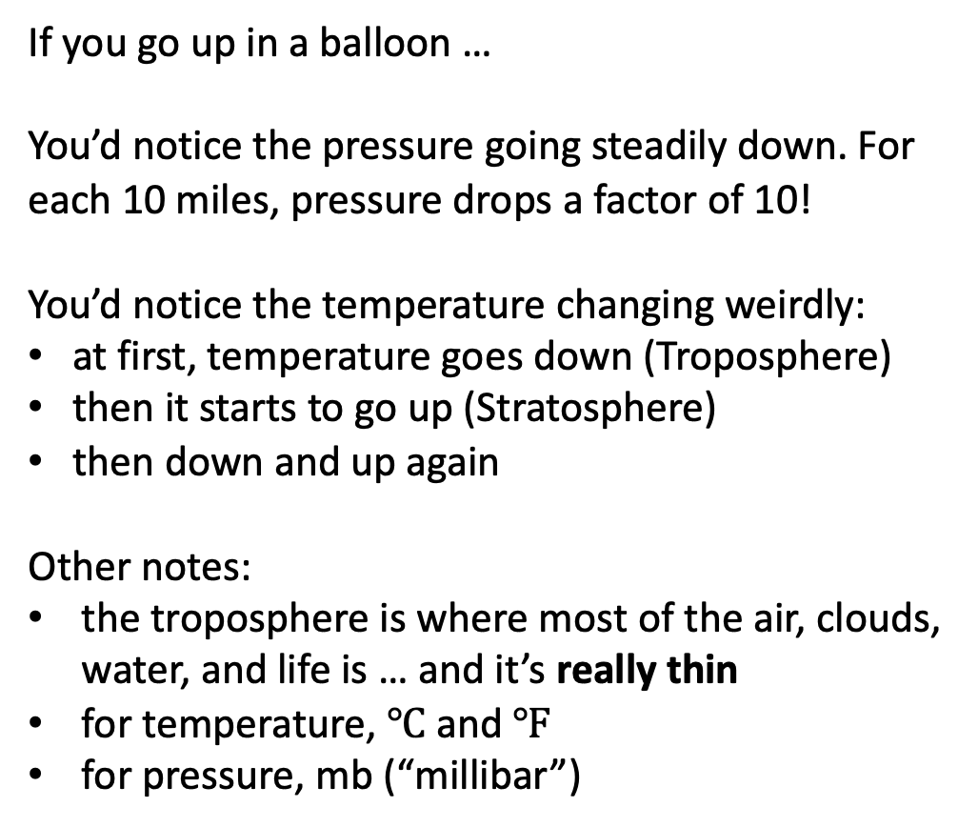
Structure of the atmosphere
If you go up in a balloon …
You’d notice the pressure going steadily down. For each 10 miles, pressure drops a factor of 10!
You’d notice the temperature changing weirdly:
at first, temperature goes down (Troposphere)
then it starts to go up (Stratosphere)
then down and up again
Other notes:
the troposphere is where most of the air, clouds, water, and life is … and it’s really thin
for temperature, $℃$ and $℉$
for pressure, mb (“millibar”)

Slide 3
About water … the three forms of water on Earth
(gas)
(solid)

Slide 4
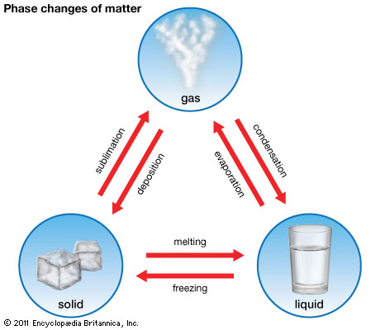
Some useful terminology about changes in water
Actually, water vapor is invisible
A phase change is a change to/from these
Water vapor (gas)
Liquid
Ice (solid)

Slide 5
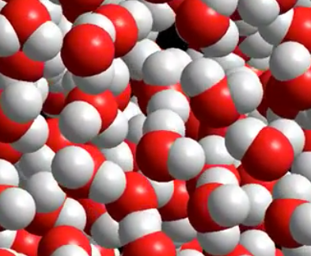
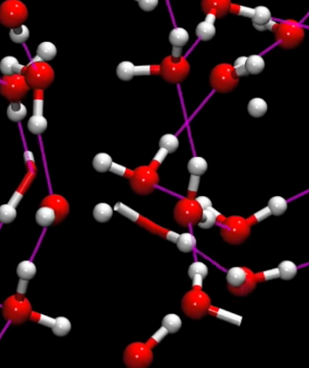
What does liquid water look like at the molecular level?
https://youtu.be/m20rGK51J0A
https://youtu.be/Zl74NCVbA5A

Slide 6
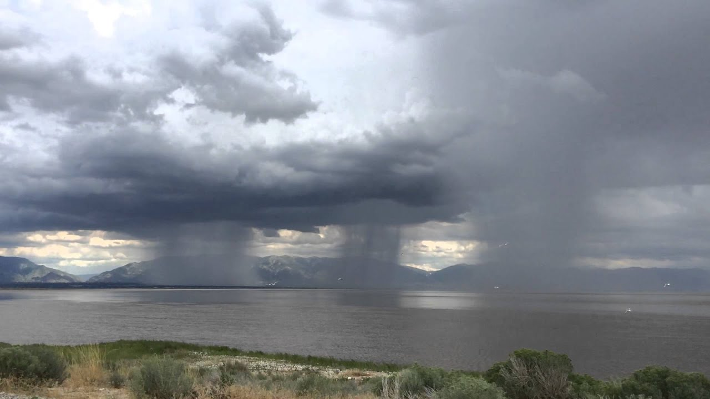
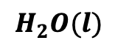
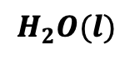
Liquid water is found in the atmosphere in two ways: cloud droplets and rain droplets
Cloud droplets
$$H_{2}O(l)$$
Rain droplets
$$H_{2}O(l)$$

Slide 7
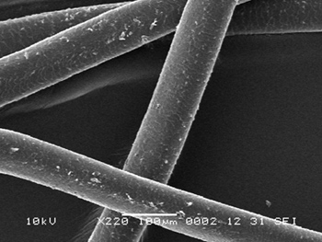


Size comparisons
Human hair width
100 $μm$
Cloud droplets
Rain droplet
The unit micrometer is symbolized $μm$
There are${10}^{6}$ (a million) $μm$ in one meter

Slide 8
Size comparisons
Cloud droplets
$$H_{2}O(l)$$
Rain droplets
$$H_{2}O(l)$$

Slide 9
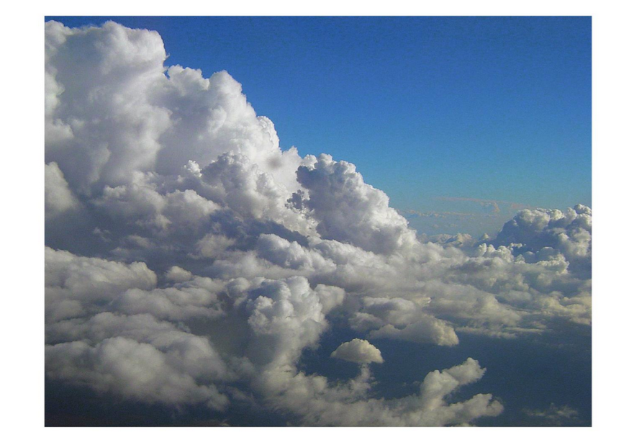
Back to the air … Here are the main gases … can you name them?

Slide 10
Composition of the troposphere
N₂
O₂
H₂O (gas)
Ar
CH₄
CO₂
Other gases 1%

Slide 11
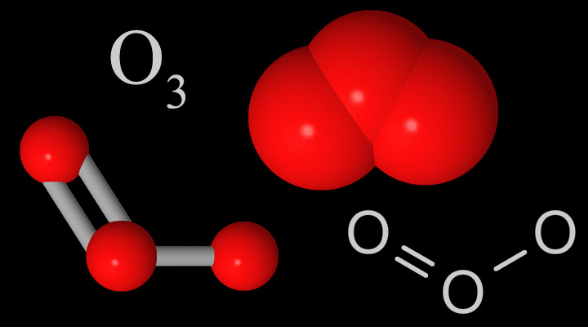
The stratosphere has more ozone (compared to in the troposphere)
N₂
O₂
H₂O (gas)
Ar
CH₄
CO₂
Other gases 1%

Slide 12
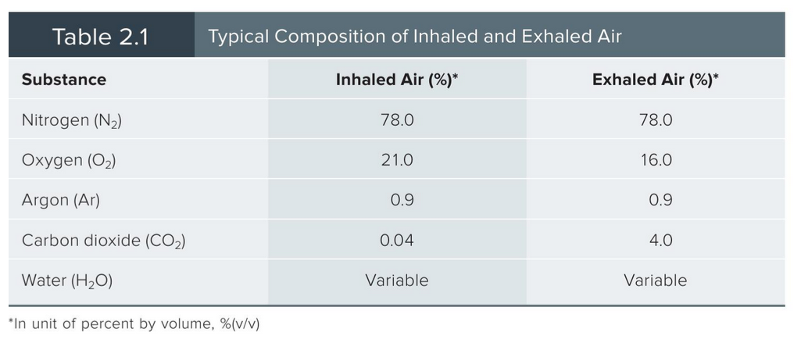
Breathing tropospheric air

Slide 13
Ways to specify trace gas concentrations
N₂ and O₂ are usually given in %
CO₂, CH₄, N₂O are usually given in ppm
CO, O₃, N₂O, NO_{x}, and SO₂ are usually given in ppb
Why three scales?

Slide 14
Ways to specify trace gas concentrations
N₂ and O₂ are usually given in %
CO₂, CH₄, N₂O are usually given in ppm
CO, O₃, N₂O, NO_{x}, and SO₂ are usually given in ppb
Why three scales? Basically, it’s easier to remember different gas concentration if the units are in the range 1-1000 (or so).

Slide 15
Ways to specify trace gas concentrations
Example:
Concentration of N₂ in air is 78%, which means if you grab 100 molecules, 78 will be N₂.
Concentration of N₂ in air is (also) 780000 ppm, which means if you grab a million molecules (1,000,000=10⁶), 780000 will be N₂.

Slide 16
Ways to specify trace gas concentrations
Example:
Concentration of N₂ in air is 78%, which means if you grab 100 molecules, 78 will be N₂.
Concentration of N₂ in air is (also) 780000 ppm, which means if you grab a million molecules (1,000,000=10⁶), 780000 will be N₂.
Conversions …
To get from ppm to %, move decimal 4 places to the left
To get from % to ppm, move decimal 4 places to the right
So what the concentration of O₂ in air, in ppm?

Slide 17
Ways to specify trace gas concentrations
Example:
Concentration of N₂ in air is 78%, which means if you grab 100 molecules, 78 will be N₂.
Concentration of N₂ in air is (also) 780000 ppm, which means if you grab a million molecules (1,000,000=10⁶), 780000 will be N₂.
Conversions …
To get from ppm to %, move decimal 4 places to the left
To get from % to ppm, move decimal 4 places to the right
So what the concentration of O₂ in air, in ppm?

Slide 18
Ways to specify trace gas concentrations
Example:
Concentration of N₂ in air is 78%, which means if you grab 100 molecules, 78 will be N₂.
Concentration of N₂ in air is (also) 780000 ppm, which means if you grab a million molecules (1,000,000=10⁶), 780000 will be N₂.
Conversions …
To get from ppm to %, move decimal 4 places to the left
To get from % to ppm, move decimal 4 places to the right
So what the concentration of O₂ in air, in ppm?
Concentration of O₂ in air is 21%
Concentration of O₂ in air is (also) ______ ppm

Slide 19
Ways to specify trace gas concentrations
Example:
Concentration of N₂ in air is 78%, which means if you grab 100 molecules, 78 will be N₂.
Concentration of N₂ in air is (also) 780000 ppm, which means if you grab a million molecules (1,000,000=10⁶), 780000 will be N₂.
Conversions …
To get from ppm to %, move decimal 4 places to the left
To get from % to ppm, move decimal 4 places to the right
So what the concentration of O₂ in air, in ppm?
Concentration of O₂ in air is 21%
Concentration of O₂ in air is (also) 210000 ppm

Slide 20
Ways to specify trace gas concentrations
Example:
Concentration CO₂ in pre-industrial times was 290 ppm, which corresponds to ______ %

Slide 21
Ways to specify trace gas concentrations
Example:
Concentration CO₂ in pre-industrial times was 290 ppm, which corresponds to 0.0290 %

Slide 22
Ways to specify trace gas concentrations
Example:
Concentration CO₂ in pre-industrial times was 290 ppm, which corresponds to 0.0290 %
Which is easier to remember, 290 or 0.0290?

Slide 23
Ways to specify trace gas concentrations
ppb (parts per billion)
This tells you how many molecules of a certain kind there will be if you grab 1,000,000 (a billion, 10⁹) air molecules.
To convert ppm to ppb, move decimal point three places to the right
To convert ppb to ppm, move decimal point three places to the left

Slide 24
Ways to specify trace gas concentrations
ppb (parts per billion)
This tells you how many molecules of a certain kind there will be if you grab 1,000,000 (a billion, 10⁹) air molecules.
To convert ppm to ppb, move decimal point three places to the right
To convert ppb to ppm, move decimal point three places to the left
Example:
Concentration N₂O in pre-industrial times was 270 ppb, which corresponds to _____ ppm

Slide 25
Ways to specify trace gas concentrations
ppb (parts per billion)
This tells you how many molecules of a certain kind there will be if you grab 1,000,000 (a billion, 10⁹) air molecules.
To convert ppm to ppb, move decimal point three places to the right
To convert ppb to ppm, move decimal point three places to the left
Example:
Concentration N₂O in pre-industrial times was 270 ppb, which corresponds to 0.270 ppm

Slide 26
Summary of way of specifying gas concentration
Percent (%) can be thought of as parts per hundred.
Atmospheric O₂ concentration is 21%. If you grab a hundred air molecules, 21 will be O₂
Atmospheric N₂ concentration is 78%. If you grab a hundred air molecules, 78 will be N₂
Parts per million (ppm) is useful when the concentration is smaller than 1%.
Atmospheric CO₂ concentration is 419 ppm (as of January, 2022) … if you grab a million air molecules, 419 of them will be CO₂
Parts per billion (ppb) is useful when the concentration is even smaller.
N₂O concentration in preindustrial times was 270 … if you grabbed a billion air molecules, 270 of them would have been N₂O
Notes:
Concentrations of CO₂, CH₄, N₂O, and other anthropogenic greenhouse gases are on the rise, so you’ll find that values in the literature vary.
Concentrations of other pollutant gases vary a lot with location
ppm and ppb are sometimes written ppmv and ppbv

Slide 27
Gas concentrations in earth.nullschool.net
Go to earth.nullschool.net and see if you can find locations that have especially high or low CO₂ concentrations.

